Slide 1
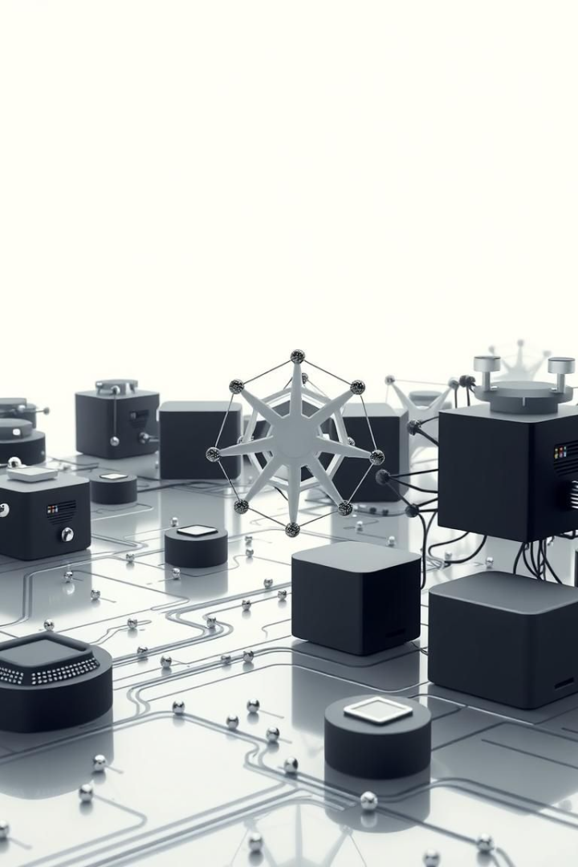
AI/ML Agent for Predicting Kubernetes Cluster Issues - Phase 1
Guidewire DEVTrails University Hackathon.
Team Name: NULL SET.

Slide 2
Introduction
Objective
Why It Matters
Build an AI/ML model. Predict issues in Kubernetes clusters.
Kubernetes clusters face pod crashes. Resource bottlenecks and network failures impact Guidewire.
Use historical and real-time metrics.

Slide 3

Data Sources and Metrics
Data Sources
Key Metrics
Kubernetes API, Prometheus, cAdvisor.
CPU utilization, memory usage, network I/O.
Ingestion
Ingest real-time and historical data to train models.

Slide 4

Model Selection and Training
Model
Tools
Data
Forecasting models (e.g., ARIMA, Random Forest, LSTM).
TensorFlow, PyTorch, scikit-learn.
2 weeks of historical cluster data.

Slide 5
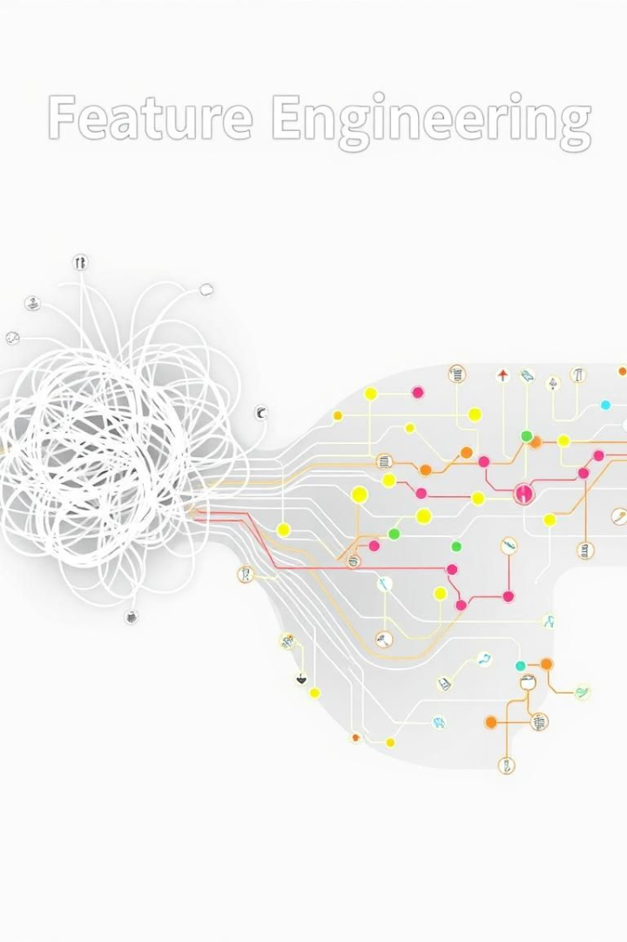



Feature Engineering
Rolling window
Fourier transforms
Trend analysis
Techniques include rolling window statistics. Fourier transforms, trend analysis and seasonality decomposition.

Slide 6



Anomaly Detection
ML Models
2
Random Forest, One-Class SVM.
Statistical Methods
1
Z-score, EWMA
Thresholds
3
Dynamically adjust based on historical data and cluster behavior.

Slide 7
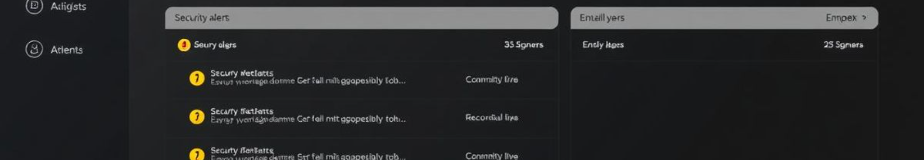



Alerting and Notification
Integration
Slack, PagerDuty, email.
Alert Levels
Warning, Critical.
Customizable
Adjust sensitivity based on needs.

Slide 8

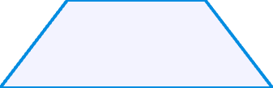


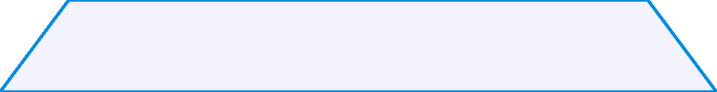
System Architecture
1
Alerting
2
Detection
3
Training
4
Engineering
5
Ingestion

Slide 9
Challenges and Mitigation
Data Quality
1
Implement validation and cleaning.
Model Drift
2
Retrain models periodically.
False Positives
3
Fine-tune thresholds.

Slide 10

Future Enhancements (Phase 2)
1
2
3
Root Cause
Scaling
Remediation
Correlation analysis and event logs.
Predictive scaling based on demand.
Integration with automated workflows.

